Slide 1
Tutorial 5: USEARCH
Kieran Lynch and Maitland Witmer

Slide 2
What is USEARCH/VSEARCH?
USEARCH / VSEARCH are softwares for preparing /processing genomic data
Variety of functionality: searching, clustering, and more
VSEARCH is an open-source alternative to USEARCH
Proven to be more efficient in various problems
Optimized for memory-efficiency over large datasets

Slide 3
Opening VSEARCH
Reads FASTA and FASTQ files
VSEARCH: 64-bit program and is only limited by the amount of memory available
USEARCH (Free version): 32-bit program with less than 4GB of memory
Result files can be in the form of FASTA, FASTQ, tables, alignments, and SAM

Slide 4
Searching
Heuristics identify sets in database with k-length sequence subsets in common with the search sequence
Index of all 4^k words is created
Frequency of words in each sequence is calculated
Sequences are sorted by frequency and the optimal global alignment is computed
Accepted sequences are sorted by similarity and returned
Enumerate all 4^k possibilities
Frequency of words in each sequence calculated and sort
Compute optimal global alignment via SWIPE in descending frequency order
Return sequences with similarity above given threshold

Slide 5
Clustering
The input sequence is clustered with the first centroid (found) sequence at above or equal provided threshold
Input sequence order based on the ID that the user puts in:
User supplied order – cluster_smallmem
Pre-sorted based on length – cluster_fast
Abundance – cluser_size
Starts with empty database of centroid sequences then uses heuristic approach (most similar) for clustering.
Empty Database
Centroid sequence is added when at or above provided threshold
Cluster of centroid sequences based on the query sequence
If no matches are found, the query sequence becomes the centroid of a new cluster and is added to the database
Notes:
The threshold is created in part from what you pick to find the sequences, (if X% doesn't match then discard), and what you decide to pick for clustering, the default is 97%. The input sequence in the order that you have the algorithm cluster is optional.

Slide 6
Other Capabilities
There are many other things that the USEARCH can do, if you are interested, please refer to the provided documentation: https://www.ncbi.nlm.nih.gov/pmc/articles/PMC5075697/
Chimera Detection
Dereplication / Rereplication
Low-complexity sequence masking
Merging of Paired-Ends Read
Sorting & Shuffling

Slide 7
Differences between VSESARCH and USEARCH
Most USEARCH commands are in VSEARCH but of course there are some additional ones and some that are missing
Additional:
Cluster_size
Fastq_convert
Missing:
Findorfs
Makeudb_ublast
Cluster_otus
Notes:
Beyond software types, there are some different commants. In our upcoming example you will see the use of cluster_otus

Slide 8
Performance
When searching for the same input query
USEARCH 7 – 5min 29s
USEARCH 8 – 5 min 57s
VSEARCH - 5min 26s
USEARCH and VSEARCH are comparable for clustering
Chimera detection: USEARCH outperformed VSEARCH 4/99 cases.

Slide 9
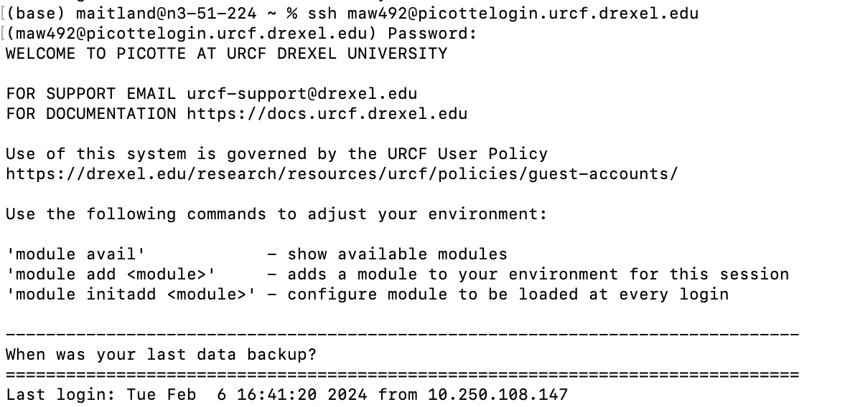
To run USEARCH
Go to https://drive5.com/usearch/download.html
Save this link for when you get to Picotte
Go and log in to Picotte
Notes:
Here is the start of the step by step guide to run the provided tutorial from usearch. Do you need to run this in picotte? Yes because in office hours we were stuck. Then I foolishly made the same mistake later.

Slide 10
Load in the software
mkdir tutorial
cd tutorial
wget https://drive5.com/downloads/usearch11.0.667_i86linux32.gz
gunzip -d usearch11.0.667_i86linux32.gz
chmod a+x usearch11.0.667_i86linux32
Check that it is in tutorial with ls.
NOTE: for the provided example make sure tutorial is lowercased to work properly.
Notes:
I strongly suggest checking the tutorial because later, if not put in correctly causes some frustration

Slide 11
Load in the example
wget https://drive5.com/downloads/misop_v10a.tar.gz
tar -zxvf misop_v10a.tar.gz
ls
If you see misop listed you did it correctly!

Slide 12
Running the example
Export usearch="/home/maw492/tutorial/usearch11.0.667_i86linux32"
-> sets the environment: replace with YOUR path in the beginning
cd misop/scripts
nano ./run.bash
—> remove the version 10 check code
nano ./run_mock.bash
—> remove the version 10 check code

Slide 13
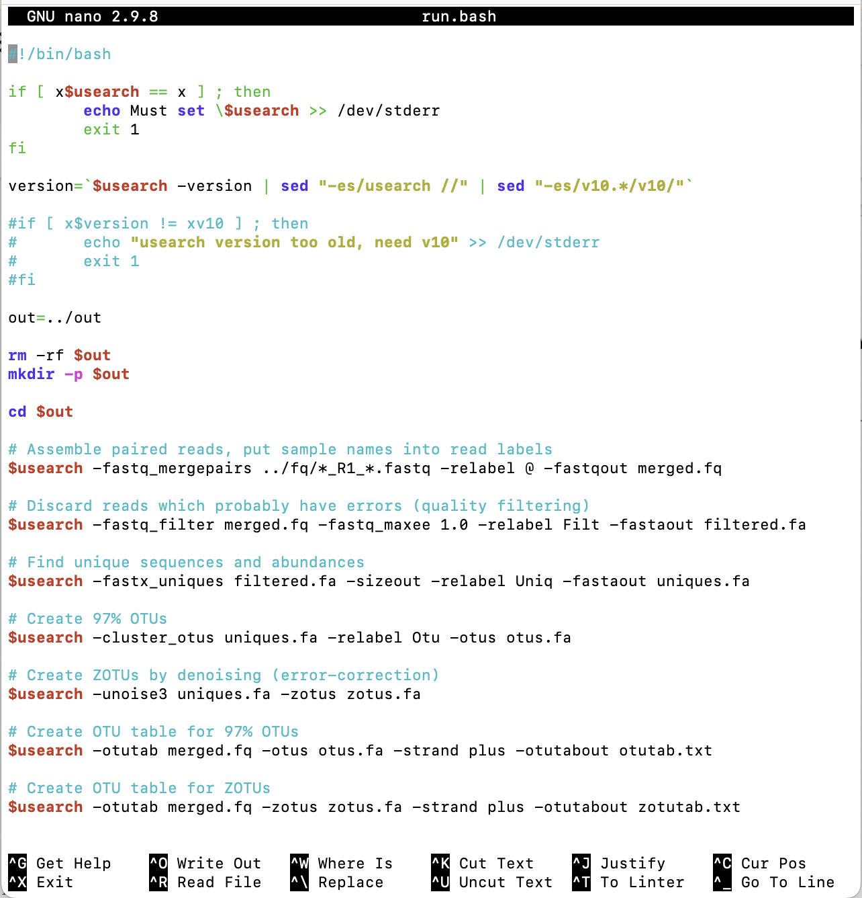
What removing version 10 looks like
Go in and use # (pound/hashtag) to comment out code.
-> If you don't you will get "usearch version too old, need v10" when you are using v11

Slide 14
Running the script file
./run.bash
./run_mock.bash
When you run the command a bunch of things are going to pop up on the screen, the overall process takes about 2 minutes for each line.

Slide 15
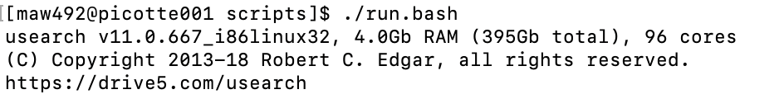
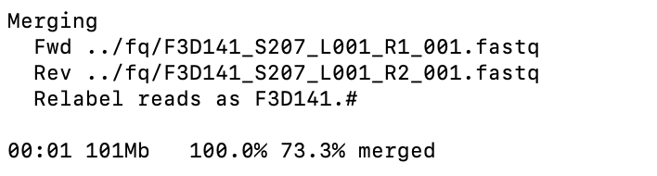
Outputs
Leting you know that you started usearch and have 4GB to use
Merging fastq files

Slide 16
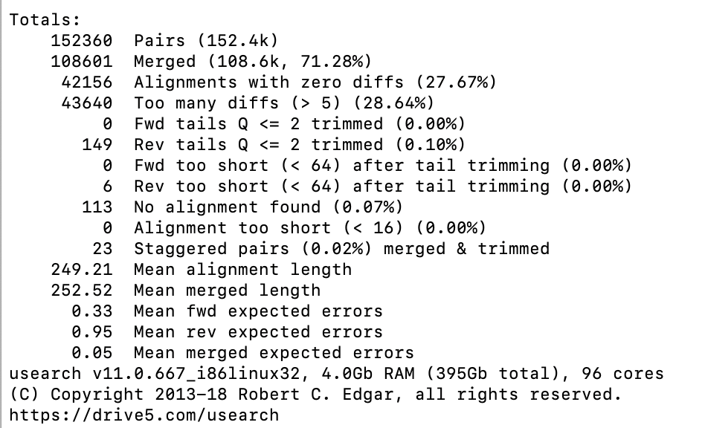
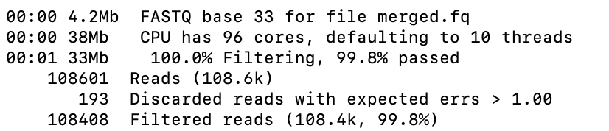
Outputs (continued)
Comes from fastq_mergepairs command
Filtering
Notes:
There wasn't a lot of documentation. The only place I could find it was from fastq_mergepairs command and review for problems. The too many diffs 28.64% are how many results were discarded because the they had more than 5 mismatches from the input. 113 were discarded because no results were found to compare too.

Slide 17
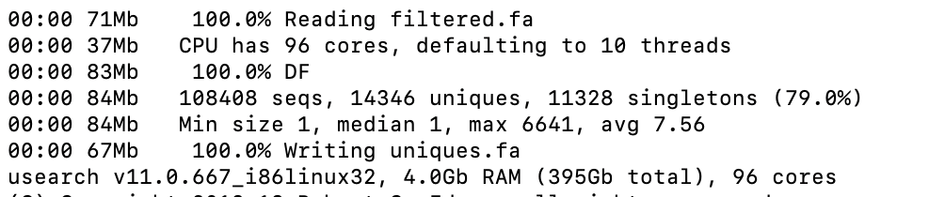
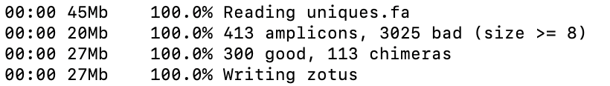
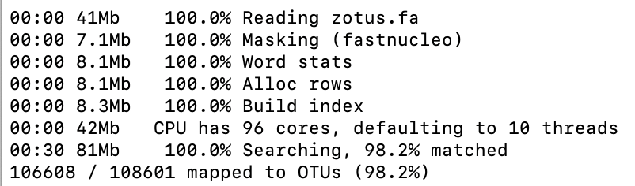
Outputs (continued)
Fastx_uniques command
Cluster_otu command
Unoise3 command
Writing the output files
Notes:
There is no documentation that I could find for what the fastx_unique run shows

Slide 18
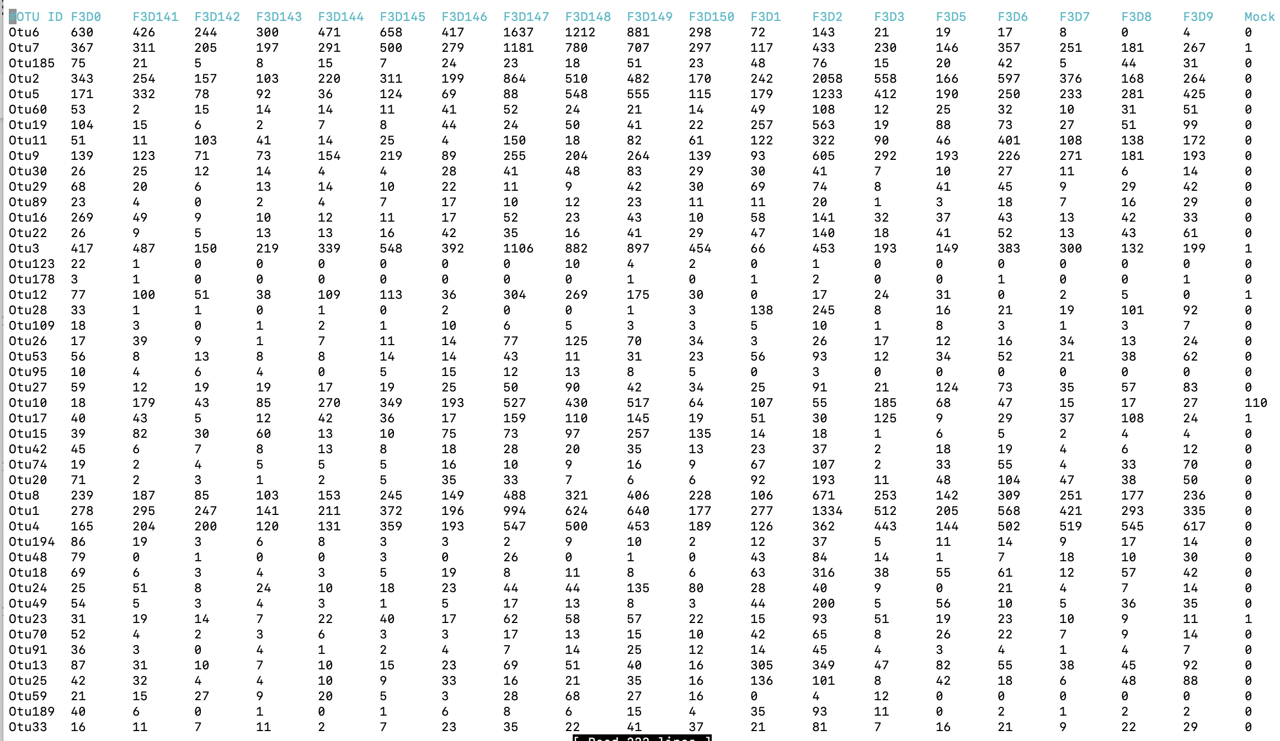

Output file: otutab.txt
Notes:
In the sample they labeled F-3-D-zero they found 630 sequences with the otu 6 label. Then they found 426 sequences from sample F-3-D-1-4-1 with the same taxomic classification.

Slide 19
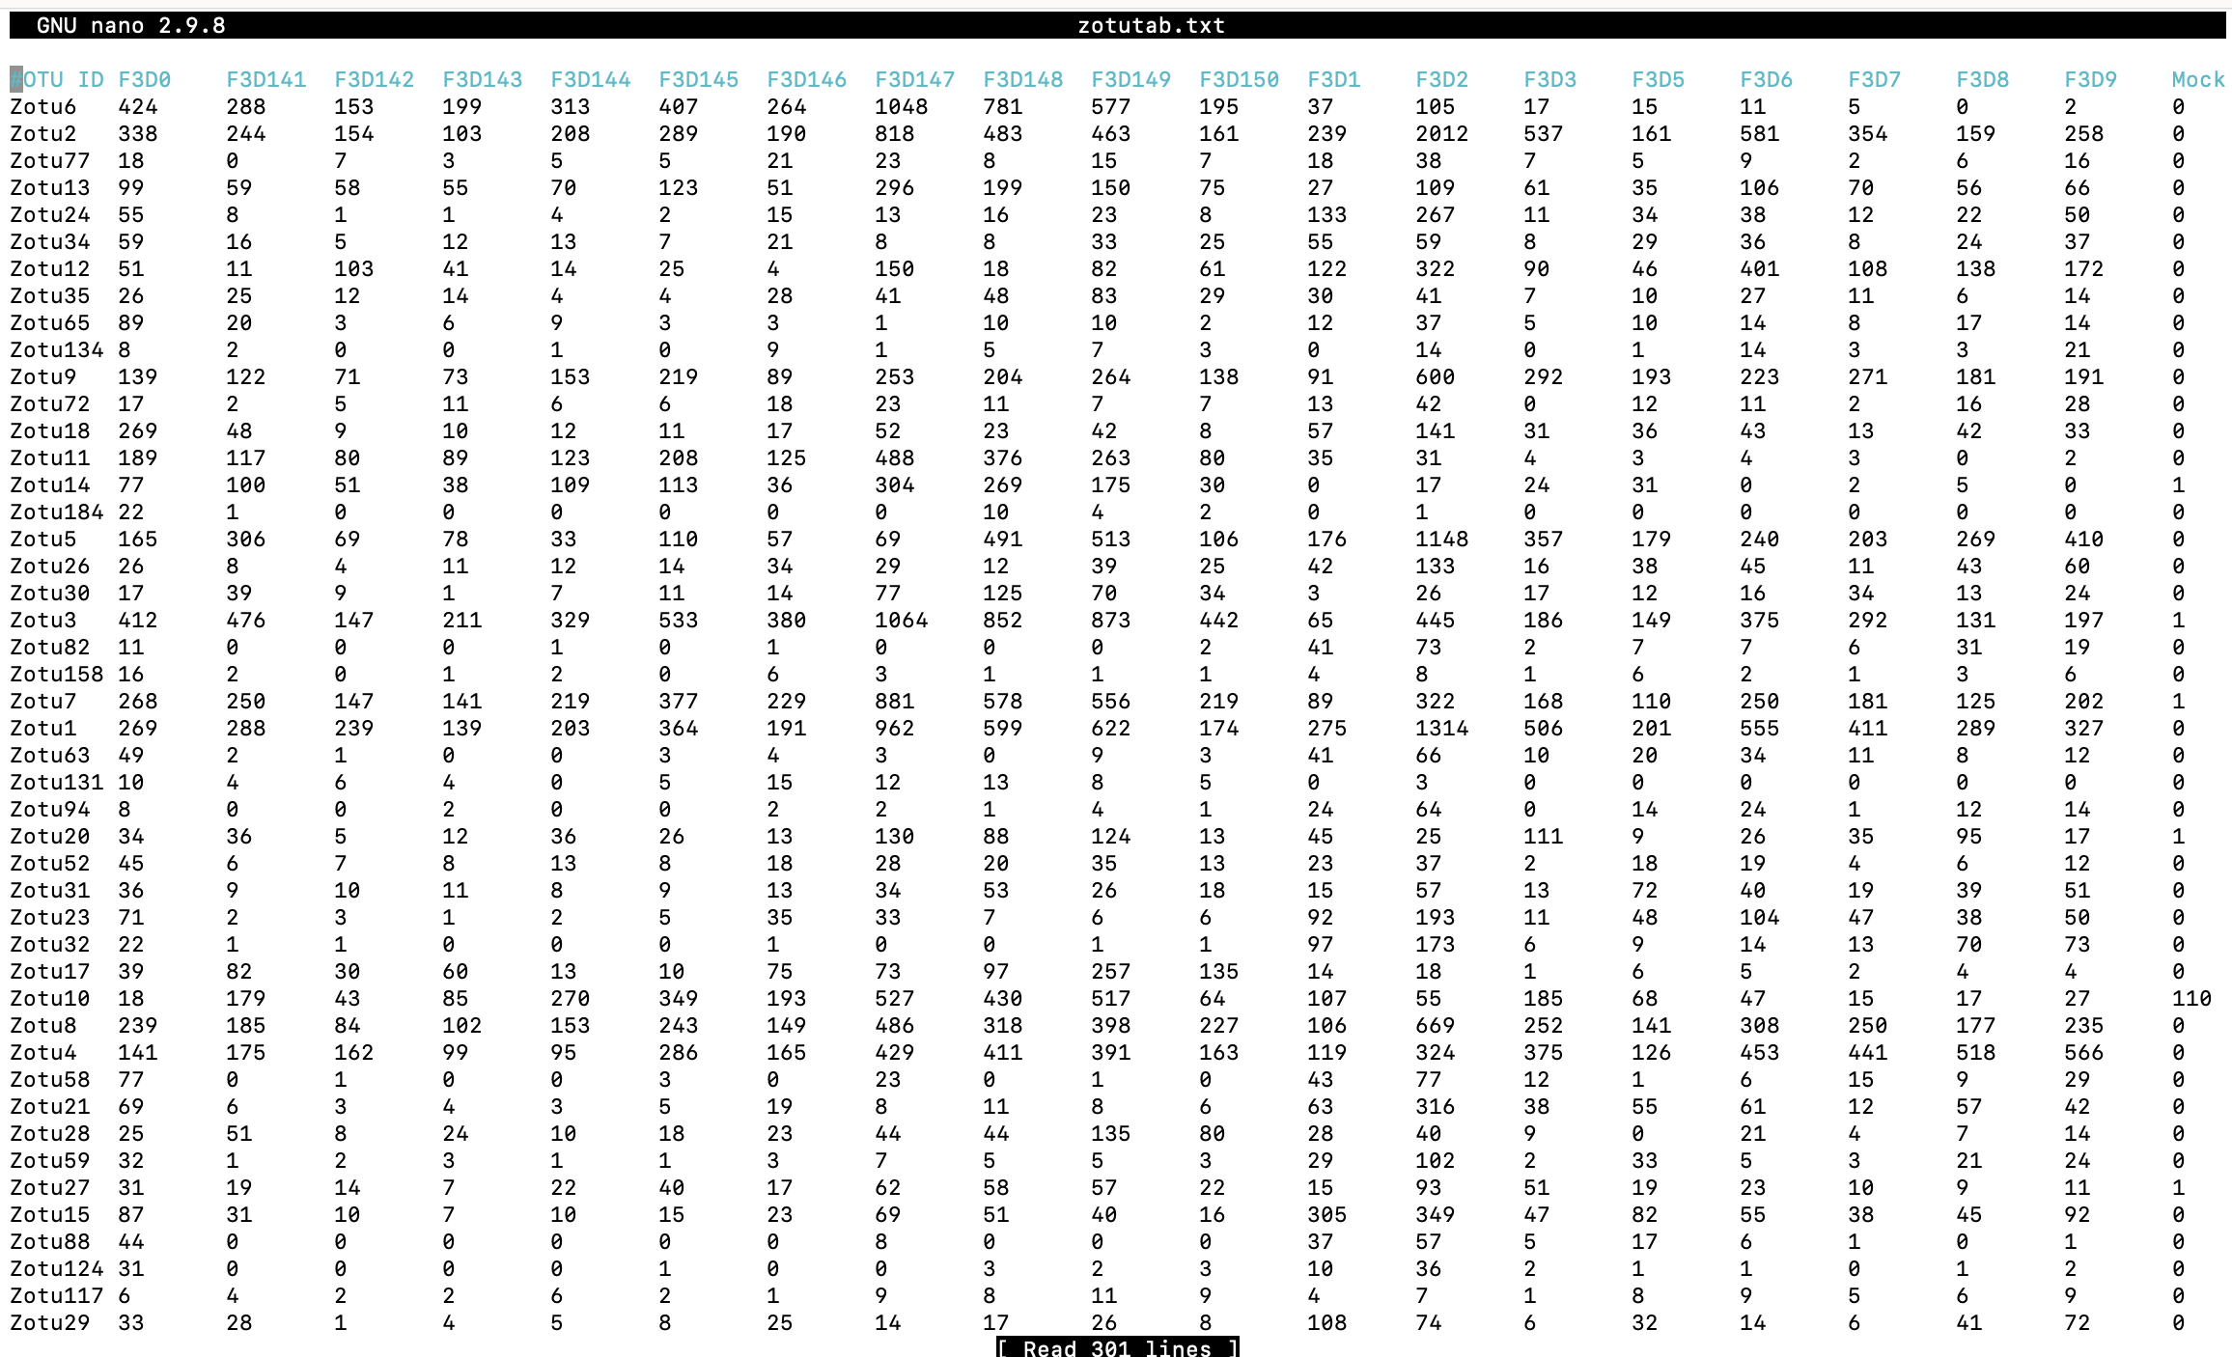
Output file: zotutab.txt
Notes:
Zotu or zero-filter otu is for diversity analysis but the table is read similarly as otus.

Slide 20
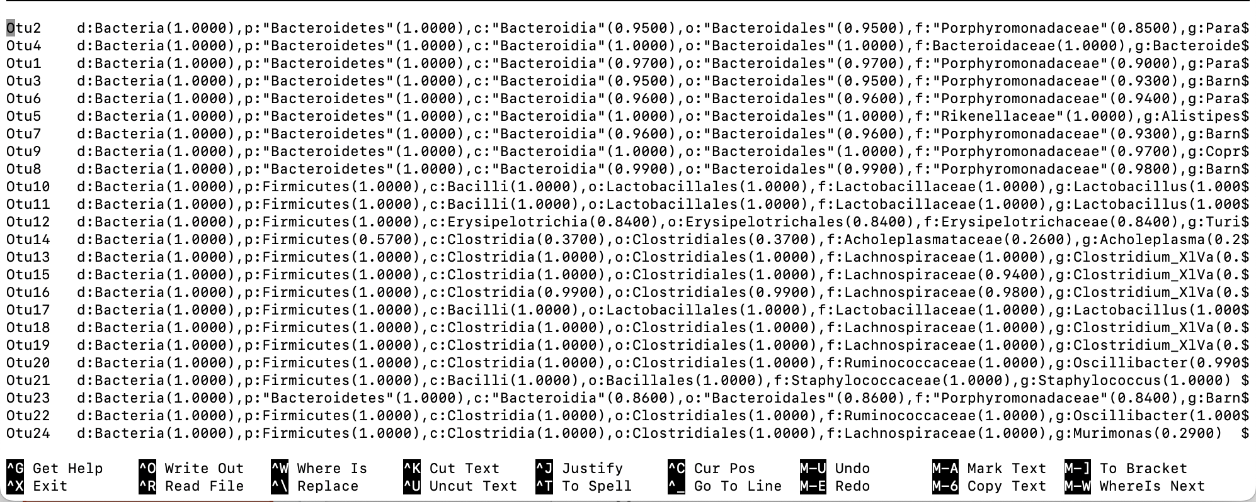
How find an idea of what the OTUs are
#!/bin/bash
mkdir –p ../sintax
mkdir -p ../exout
usearch -sintax ../fq/*_R1_*.fastq -db 16s.udb -tabbedout ./sintax/rdp_16s_v16.fa
$usearch -sintax ../out/otus.fa -db ../sintax/rdp_16s_v16.fa -strand plus -tabbedout ../exout/otus_sintax.txt
Notes:
You are going to make a scripts file with the following commands. In your ASSUMING you write it in the scripts file. This is from the run.bash example

Slide 21
Zoom in on first line
Otu2 d:Bacteria(1.0000),p:"Bacteroidetes (1.0000),c:"Bacteroidia"(0.9500),o:"Bacteroidales"(0.9500),f:"Porphyromonadaceae"(0.8500),g:Parabacteroides(0.4600)
These are the how confident the algorithm is for each level of classification for the otu, in this case otu 2.
(d) Domain, (p) phylum, (c) class, (o) order, (f) family, (g) genus
Species is not included
Notes:
The confidence levels are from bootstrapping

Slide 22
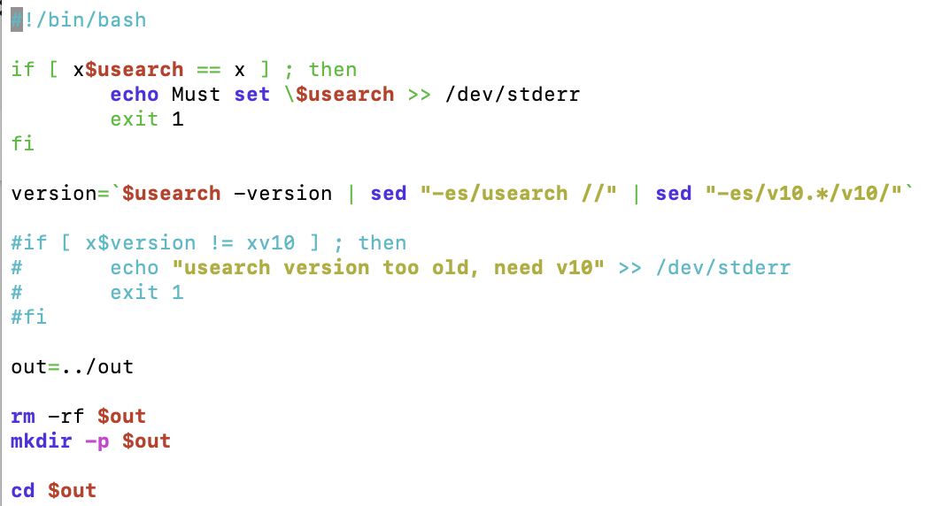
Inside the script files
This is checking to find the environment. This was the export line earlier.

Slide 23
Inside the script files
Checks the version

Slide 24
Inside the script files
Stores the output files in misop/out

Slide 25
Usearch Commands
Assembles paired-end reads to create consensus sequences
Wildcards and -relabel @ option can merge multiple files and add sample identifiers to the read labels
Can convert FASTQ file to FASTA format.
Discard reads > E total expected errors for all bases in the read
Find set of unique sequences, also called dereplication.
-sizeout option specifies size annotations in output sequence labels.

Slide 26
Usearch Commands Part 2
Defaults to 97% OTU threshold using the UPARSE-OTU algorithm.
Chimeras are filtered by this command.
Uses the UNOISE algorithm to perform denoising (error-correction)
otutab command generates an OTU table by mapping reads to OTUs.
Database is specified with -otus / -zotus
-strand searches both sequences

Slide 27
Why is VSEARCH important?
VSEARCH's open-source nature in conjunction with its excellent performance benefits development
All the capabilities in the VSEARCH tool makes it very convenient to process FASTQ/FASTA files
Searching & Clustering are fundamental techniques to identify patterns in sequences
Allows for better transparency into microbiome analysis pipelines (i.e. QIIME)

Slide 28
Sources
https://drive5.com/usearch/manual/
https://www.ncbi.nlm.nih.gov/pmc/articles/PMC5075697/

